Slide 1

Required Sample Sizes for Data-Driven Market Segmentation Analyses in Tourism
Journal of Travel Research 2014, Vol. 53(3) 296–306 © 2013 SAGE Publications Reprints and permissions: sagepub.com/journalsPermissions.nav DOI: 10.1177/0047287513496475 jtr.sagepub.com
Sara Dolnicar1 , Bettina Grün2 , Friedrich Leisch3 , and Kathrin Schmidt4
Keywords: market segmentation, cluster analysis, sample size, k-means, simulation study

Slide 2
Exploring the issue of determining the appropriate sample size required for market segmentation using k-means clustering in the tourism sector:
Unsupervised learning and k-means clustering are widely used for market segmentation in tourism.
The paper addresses a key issue: how large should a sample size be to ensure reliable clustering?
The authors use simulation studies with artificial data to explore how different factors (number of variables, clusters, noise) affect clustering accuracy.
The adjusted Rand index is used to measure the accuracy of the segmentation.
The recommended sample size is 70 times the number of variables in the segmentation task.
Larger sample sizes improve clustering results, especially for complex segmentation tasks with many variables or noise.
This study provides practical guidelines for researchers and businesses in tourism to determine the required sample size for segmentation studies.
The 70-times rule offers a conservative but practical approach to determine sample size.
Future work could refine these guidelines for different clustering algorithms or data types.

Slide 3
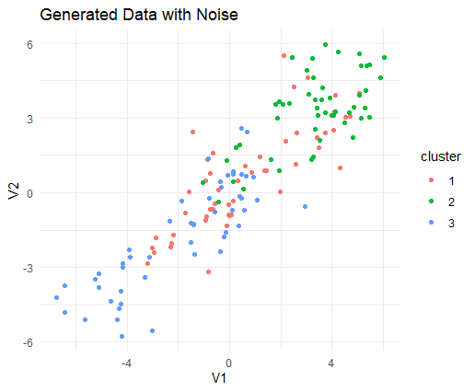
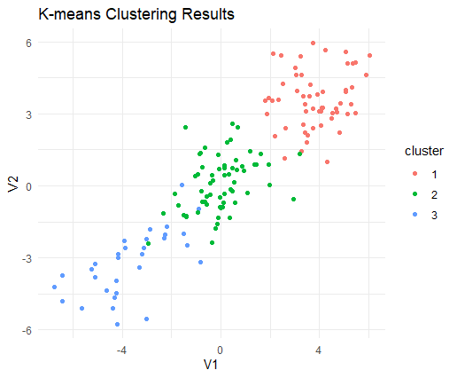
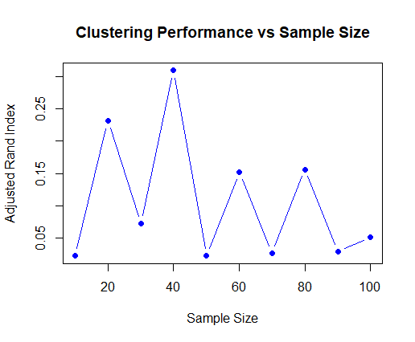
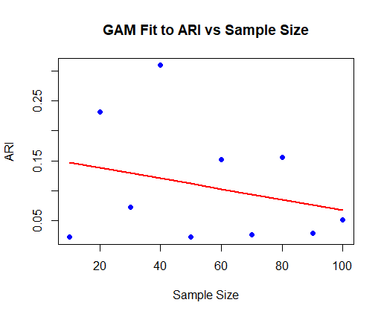
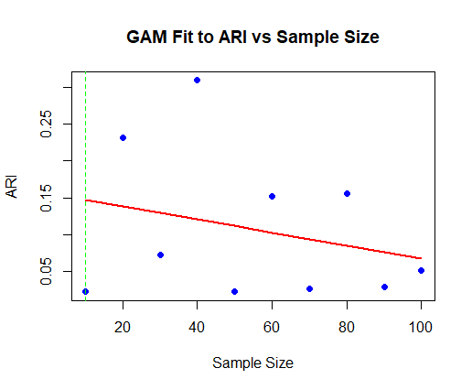
Stage 3: Performance Evaluation Using Adjusted Rand Index (ARI)
Stage 1: Data Generation
Stage 2: K-means Clustering
Stage 4: Generalized Additive Model (GAM) Analysis
Stage 5: Deriving Guidelines for Sample Size

